Slide 1
Model-Based Reasoning in Human Evolution
Paolo R. Crocchiolo

Slide 2
Svante Pääbo (Nobel 2022) John Bellamy Foster: «Return to Nature» (Monthly Review, Jan 2023)

Slide 3
Evolutionary Trees

Slide 4
Lamarck vs. Darwin
Teorie istruttive
Teorie selettive
Trasformazione
Scopi
Variazione
Risultati

Slide 5
Motori di variazione
1. Mutazioni
2. Rimescolamento genetico nella riproduzione sessuata

Slide 6
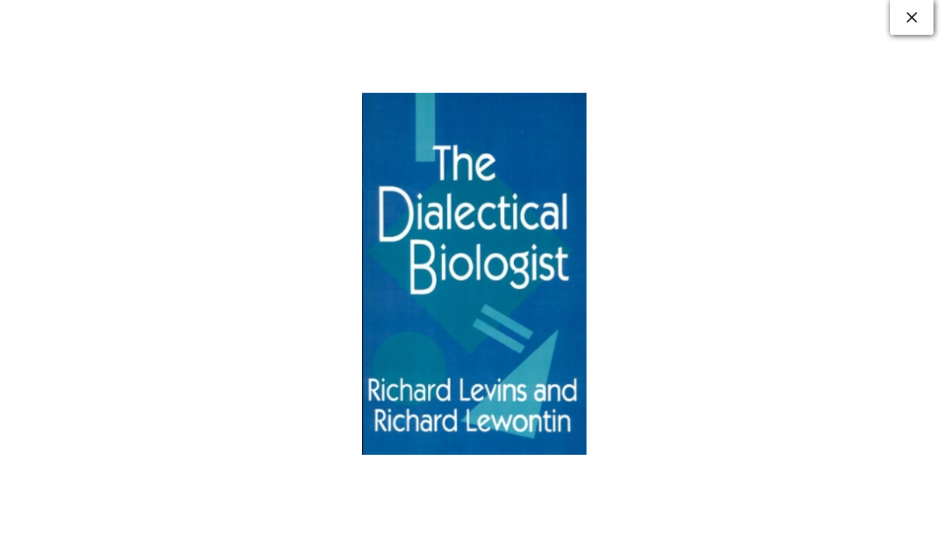
The evolutionary process is a typically dialectic process

Slide 7
What is Science?
These are the properties of things that we call dialectical: that one thing cannot exist without the other, that one acquires its properties from its relation to the other, that the properties of both evolve as a consequence of their interpenetration
We believe that science, in all its senses, is a social process that both causes and is caused by social organization. The denial of the interpenetration of the scientific and the social is itself a political act, giving support to social structures that hide behind scientific objectivity to perpetuate dependency, exploitation, racism, elitism, colonialism
Human beings see the natural world as a reflection of the social organization that is the dominant reality of their lives. (Levins, Lewontin, The Dialectical Biologist)

Slide 8
Platone - dialettica delle idee Aristotele – fissismo (essenzialismo), entelechia Democrito, Epicuro Lucrezio (De rerum natura, liber V, vv. 800 e sgg.) (clinamen, Ibid., II, 216 e sgg.) Plinio il Vecchio, Columella (classificazione delle piante)

Slide 9
Il Medio Evo
Minima attenzione alle scienze naturali
Studio e classificazione dei rimedi (Ildegarda di Bingen)
Adozione dei modelli antichi, inseriti in una visione prettamente creazionista
La «scala naturae» riflette l’immutabilità delle gerarchie sociali

Slide 10
Scala naturae
Dio
Il sacro (gli angeli)
L'umanità
Il mondo animale
Il mondo vegetale
Il mondo minerale

Slide 11
Dal Rinascimento all’Illuminismo Le grandi esplorazioni geografiche fanno conoscere un’immensa varietà di specie animali e vegetali prima sconosciute in Europa

Slide 12
Geocentrismo - Eliocentrismo
Essendo la scienza ancora rigidamente ancorata alla teologia, il dibattito si concentra sulla posizione della terra al centro dell’universo, senza mettere in discussione per il momento la scala naturae e la posizione «eccezionale» dell’uomo separata dal resto del mondo vivente

Slide 13
Il problema dei fossili e Stenone Primi studi di anatomia comparata (John Ray) Classificazione tassonomica delle specie vegetali e animali ad opera di Linneo, ancor oggi in gran parte adottata Con Linneo si chiude la fase «pre-illuministica» delle scienze naturali

Slide 14
L’Illuminismo
Visione laica delle scienze naturali (sia pure ancora parzialmente da conciliare con riferimenti biblici)
Buffon, Cuvier, Geoffroy de Saint-Hilaire (creazioni multiple per spiegare l’estinzione di animali vissuti in passato, definizione biologica di specie [prole feconda], unità del piano corporeo, antenato comune di uomo e scimmia, comunanza del piano archetipico trasversale a classi e tipi [evoluzione?])
Jean Baptiste de Lamarck e la teoria istruttiva dell’evoluzione delle specie

Slide 15
L’empirismo inglese
Erasmus Darwin, Charles Lyell
Charles Darwin, Alfred Wallace e la teoria dell’evoluzione per selezione naturale
Thomas Huxley (il posto dell’uomo nella natura)

Slide 16
Reazioni al pensiero di Darwin
Rifiuto in blocco (dogmatismo religioso – e.g. Samuel Wilberforce, Chiesa Catttolica)
Irrazionalismo spiritualista (élan vital – Henri Bergson)
Rozzo materialismo positivista $→razzismo$(Herbert Spencer, falsa rappresentazione del pensiero di Darwin, «darwinismo sociale», Carl Vogt, Jakob Moleschott, Ernst Haeckel $→$riduzionismo meccanicista ontogenesi come ricapitolazione della filogenesi Francis Galton $→$ eugenetica)
Nietzsche

Slide 17
La Conferenza di Berlino 1884 The «Scramble for Africa»

Slide 18
Gregor Mendel

Slide 19
Hugo de Vries (pangeni) August Weismann (barriera)

Slide 20
The Dialectics of Nature

Slide 21
A Naturalistic Vision of Man
Like all other living beings, humans are the result of a long evolutionary history of dialectic gene-environment interactions.
In this perspective, all animals, including man, have evolved as survival and, potentially, reproductive machines, and each individual of any species turns out to be a variant of that very species’ genome.

Slide 22
Individual-Species Relationships
Both species and individuals are dialectically related to each other as instruments of their genome’s propagation, which is spacewise entrusted to the physically separated individuals, and timewise to the species itself, the latter representing the actual genome’s repository spreading through the generations (Bruce S. Lieberman, and Elisabeth S. Vrba, “Steven Jay Gould on species selection, 30 years of insight”, Paleobiology, 31, 2: 113-121 [2005])
In turn, any species, including ours, is dialectically related to, and co-evolving with, all other living species and, ultimately, with the non-living environment of our planet; whereas, within the single individual, the genes are dialectically related to, and evolving with, the entire organism determining its genetically pre-programmed phases of development.

Slide 23
Mechanistic Reductionism vs. Dialectic Emergentism

Slide 24
The Concept of Emergent Property
Interdependence of the Parts of a Whole
The Whole is More than the Sum of its Parts
E.g. : Force of Gravity = Emergent Property of Two or More Objects Placed in Space at a Certain Distance; Replication = Emergent Property of a Specific Combination of DNA Molecular Components; Motion resulting from a Specific Combination of the Single Components of a Car; etc.

Slide 25
The Dialectics of Evolution intertwining with the Dialectics of Human Evolution
1. Inorganic and Organic Interacting
2. Asexual and Sexual Reproduction
3. Survival, Growth, and Homeostatic Balance
4. Reciprocal Adaptation Path of a Given Species and its Environment
5. Natural Environment and Human Social/Cultural Environment

Slide 26
Human Evolution
Human Evolution
Climate Changes triggering Bipedalism
Bipedalism triggering Manual Mobility – Feedback on Bipedal Skills
Manual Mobility triggering Brain Enlargement – Feedback on Manual Skills
[Hands Transforming Minds (-Brains), and Minds (-Brains) Transforming Hands]
Brain Enlargement triggering Self-Consciousness – Feedback on Brain Plasticity
Self-Consciousness triggering Economic/Social/Cultural/Political Setups – Feedback on Climate Changes

Slide 27
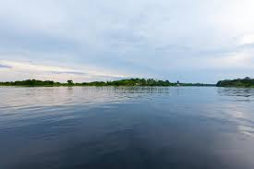
Life as a Heraclitean River

Slide 28
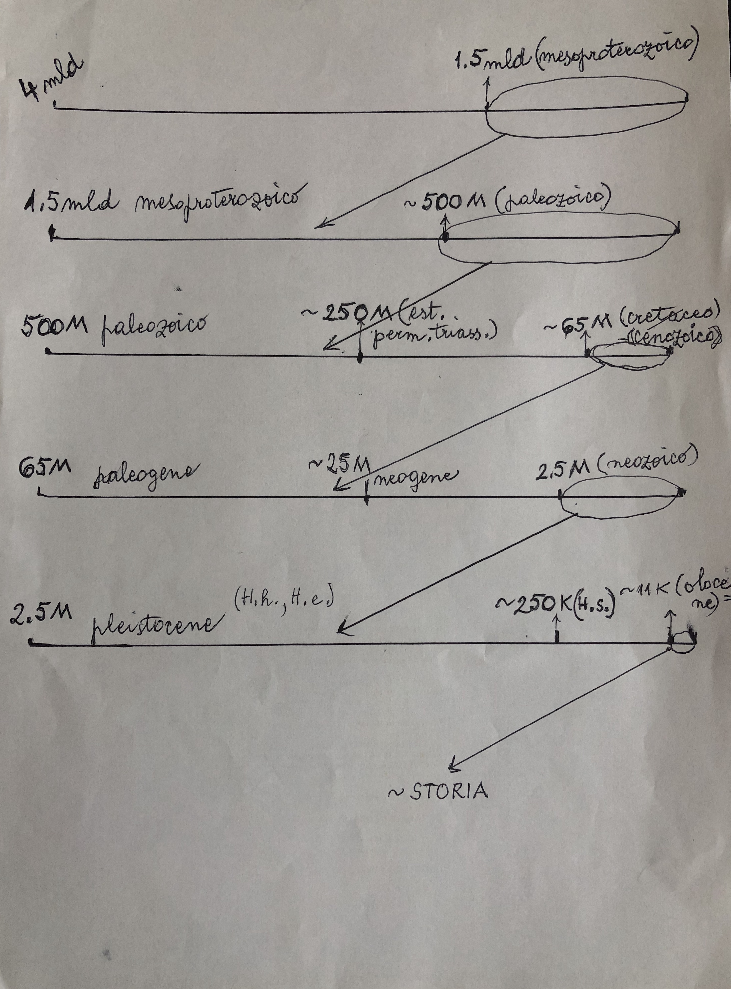

Slide 29
Oxygen and Cyanobacteria

Slide 30
A Network of Dialectically Interacting Constraints
Niche Construction

Slide 31
Yin Yang Dialectics

Slide 32
IndividualMind-Body/Collective Mind-Body
Capitalist Niche Construction
Socialist Niche Construction
Interactions with Flexible Minds
Reciprocal Conditioning of (Body-)Minds and Kinds of Societies

Slide 33
Evolution = Co-evolution
Evolver and evolved (interchangeable subject and object) interact with, and transform into, each other, at the same or at a different pace

Slide 34
Intelligent Design?

Slide 35
Ring Species

Slide 36
BI-DIRECTIONAL SELECTION Human Minds both selecting, and being selected by, their Natural, Social and Cultural Environment. Selected as they turned out to best cope with their Niche in the Past Generations. What about the Future Generations?

Slide 37
Exaptation

Slide 38
1. Asexual and Sexual Reproduction
Living emerging from Non-living

Slide 39
Consciousness as Emergent Property
Consciousness emerging fron What has no Consciousness (A. Damasio)

Slide 40
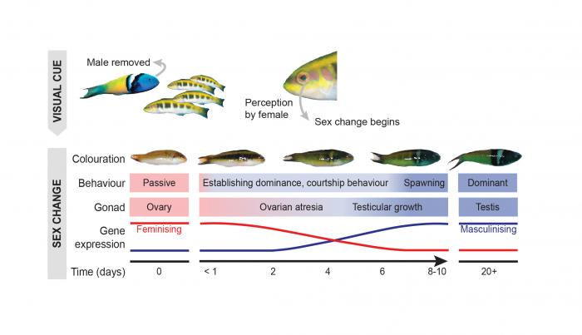
Degrees of Genetically Predisposed Flexibility Depend on Environmental Conditions
Fishes are the only vertebrates that undergo sex change during their lifetime, but even within this group, a unique reproductive strategy is displayed by only 1.5% of the teleosts. This lability in alternating sexual fate is the result of the simultaneous suppression and activation of opposing male and female networks.
Fishes are the only vertebrates that undergo sex change during their lifetime, but even within this group, a unique reproductive strategy is displayed by only 1.5% of the teleosts. This lability in alternating sexual fate is the result of the simultaneous suppression and activation of opposing male and female networks.

