Slide 1
Polarization and its discontents: Morocco before and after the Arab Spring
Fabio Clementi (Università di Macerata)
Haider A. Khan (University of Denver, CO, USA)
Vasco Molini (World Bank, Washington DC, USA)
Francesco Schettino (Università della Campania, L.Vanvitelli)
Khalid Soudi (Haut Commissariat au Plan, Rabat, Maroc)
Welfare and market: a social, economic and legal analysis
18/10/2019
Università Giustino Fortunato

Slide 2
Outline
The Arab World before and after the Arab Spring
Absolute vs Relative
Morocco: 2001-2013
Absolute measures and perception in Morocco: 2001-2013

Slide 3
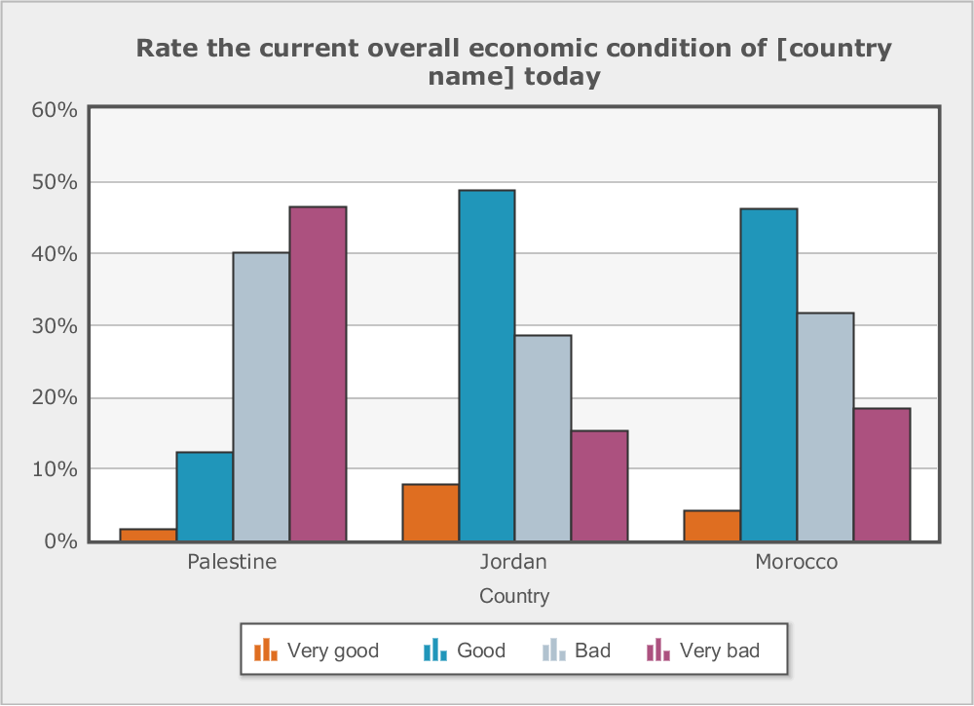
Perception on economic situation in 2007

Slide 4
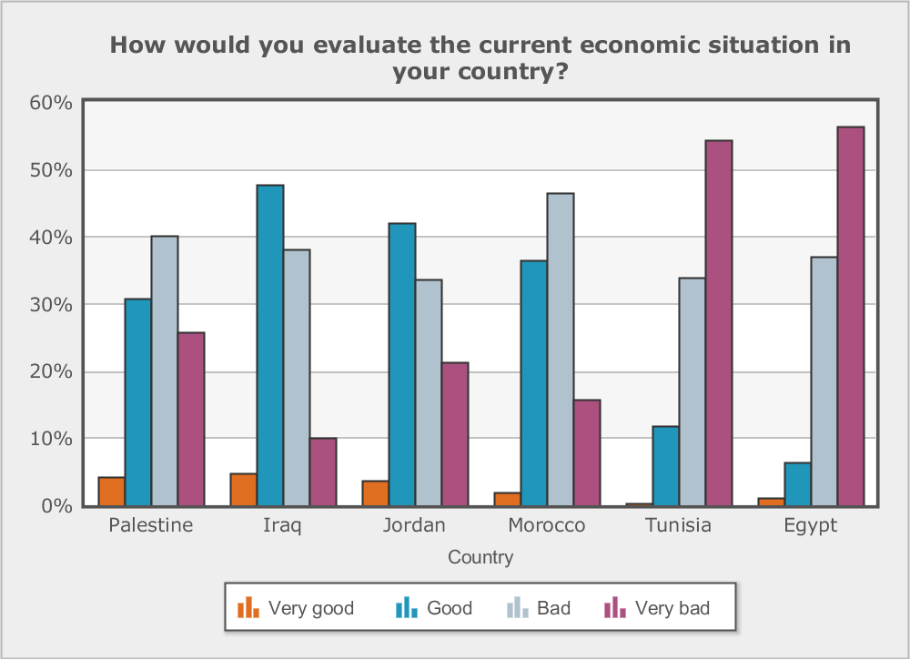
Perception on economic situation in 2013

Slide 5
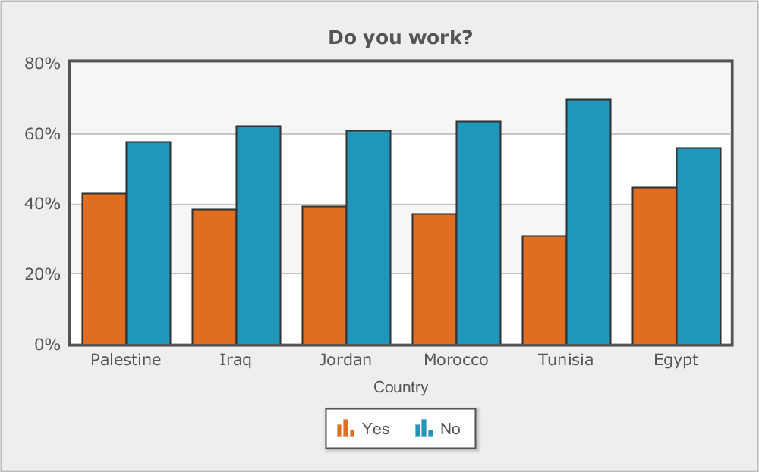
Are they negative because..?

Slide 6
Relative Gini Indexes in the MENA Region: 2001-2016

Slide 7
Welfare distribution and dissatisfaction in MENA
There seems to be no correlation between this generalized dissatisfaction and inequality (Devarajan and Ianchovichina, 2017).
Inequality has been stagnant or declining since the end of 90’s (Belhaji 2012, Verme, 2016) although some works (Alvaredo et al., 2018) question the veracity of the figures arguing that they are underestimated.
Polarization, often identified as one of the root causes of social instability and conflicts (Esteban and Ray 2015) is moderate and stable throughout the period.
Recent evidence suggests that polarization translates into open conflict in MENA region only in presence of non-humanitarian, non-neutral intervention (Abu Badr, Ianchovichina a, 2018)

Slide 8
Absolute vs Relative

Slide 9


Absolue vs Relative
Notes:
Au niveau national, l’incidence de la pauvreté est passée de 15,3% en 2001 à 8,9% en 2007 et à 4,8% en 2014. Par milieu de résidence, l’incidence de la pauvreté est respectivement passée de 7,6% à 4,9% et à 1,6% en milieu urbain et de 25,1% à 14,4% et à 9,5% en milieu rural.
Bien que la pauvreté ait été rapidement résorbée dans les deux milieux de résidence, force est de constater que la baisse a été plus prononcée en milieu urbain qu’en milieu rural.
Aux seuils internationaux de 1,9 et 3,1 USD en PPA 2011 par jour, le Maroc atteignait respectivement un taux de pauvreté de 0,8% et 5,8% en 2014, inferieur à ceux de l'Iran, du Mexique et de la Roumanie au cours de la même période.

Slide 10
And if you don’t trust us…
“Consider an economy with just two household incomes: $1,000 and $10,000. If both incomes double in size then relative inequality will remain the same; the richer household is still 10 times richer. But the absolute difference in their incomes has doubled, from $9,000 to $18,000. Relative inequality is unchanged but absolute inequality has risen” (Martin Ravallion, 2003).

Slide 11
Our hypothesis: Absolute inequality affects perception
The subjective perception of a rising inequality appears often to be referring to the absolute concept of inequality (Ravallion, 2003).
In experiments used to identify which concept of inequality is held by people, it was found that 40% of participants thought about inequality in absolute terms (Ravallion, 2003).
It is arguably absolute inequality that most people see in the daily lives and that motivates their concerns about distributive justice when they talk about the ‘gap between the rich and the poor’ and the ‘widening economic divide’ (Amiel and Cowell, 1999)”.

Slide 12
Morocco: 2001-2013

Slide 13
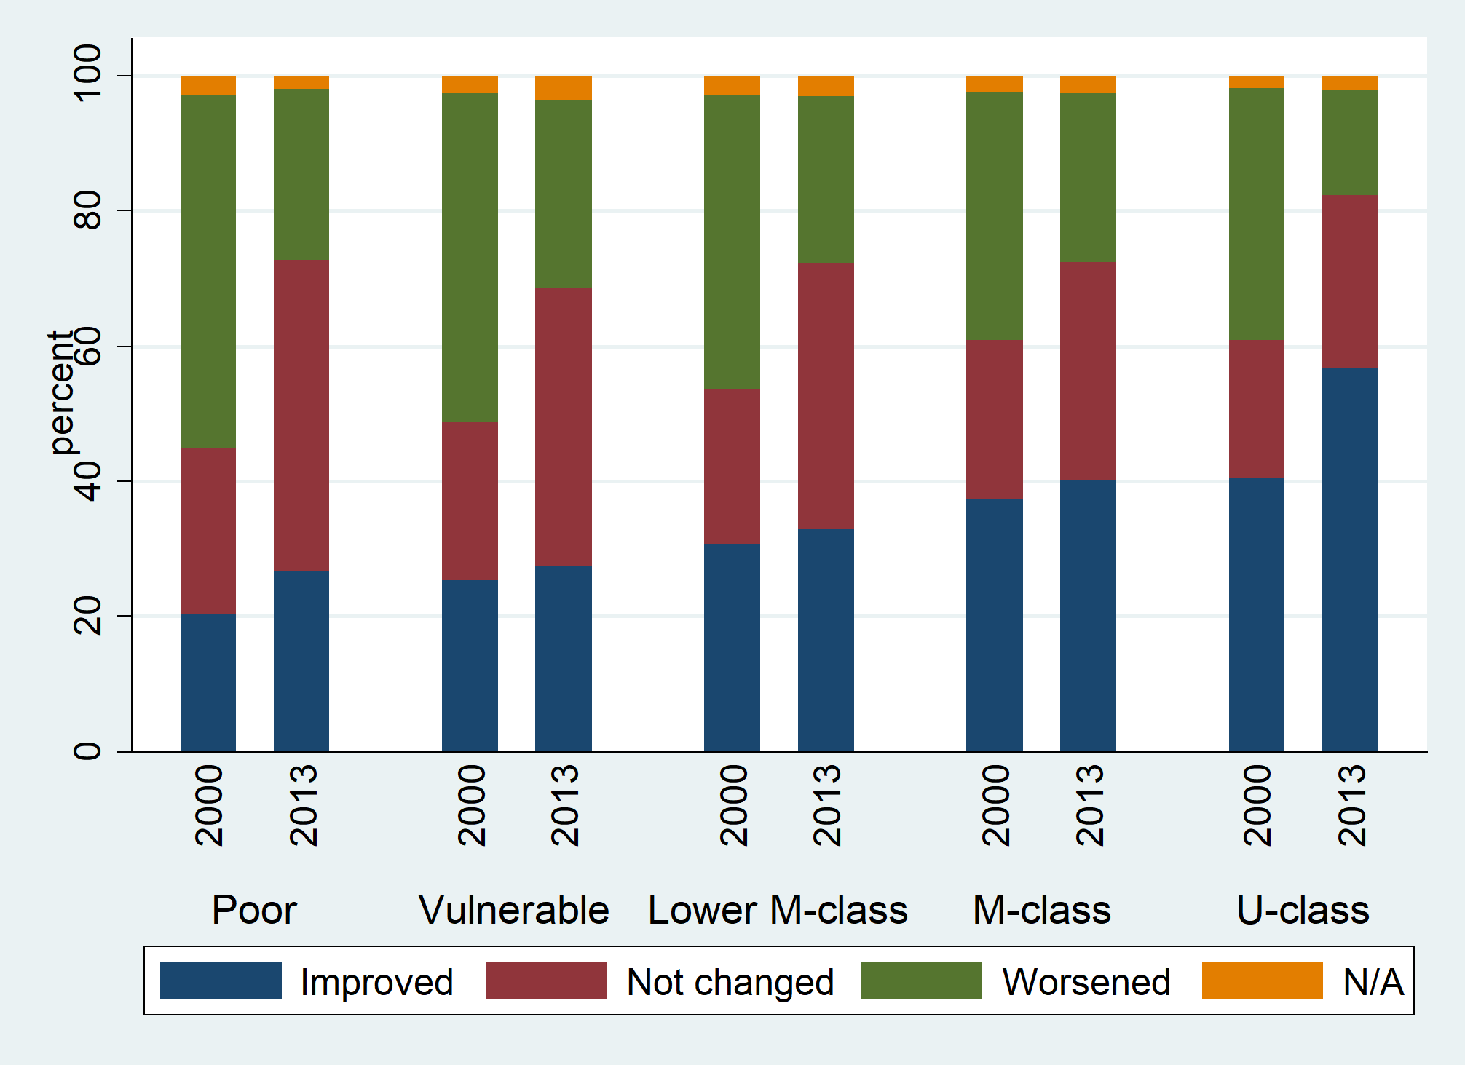
Perception of current living standard compared to the last 10 years

Slide 14
Perception of HHs social level in comparison with own social environment

Slide 15
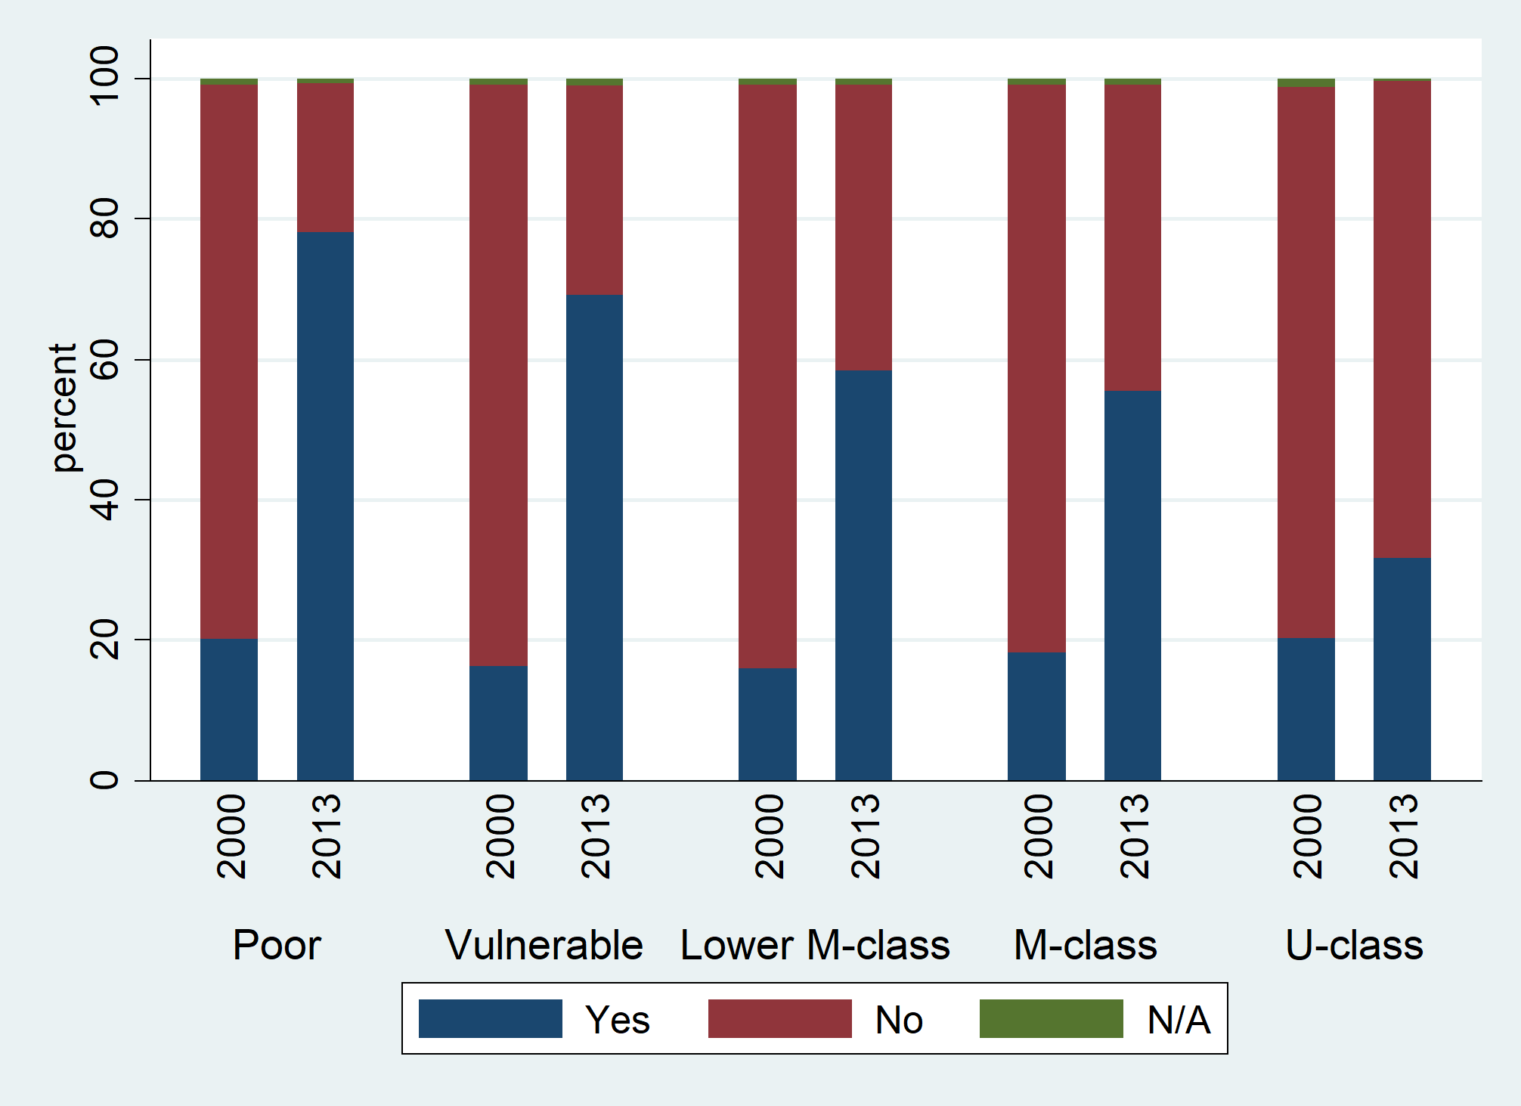
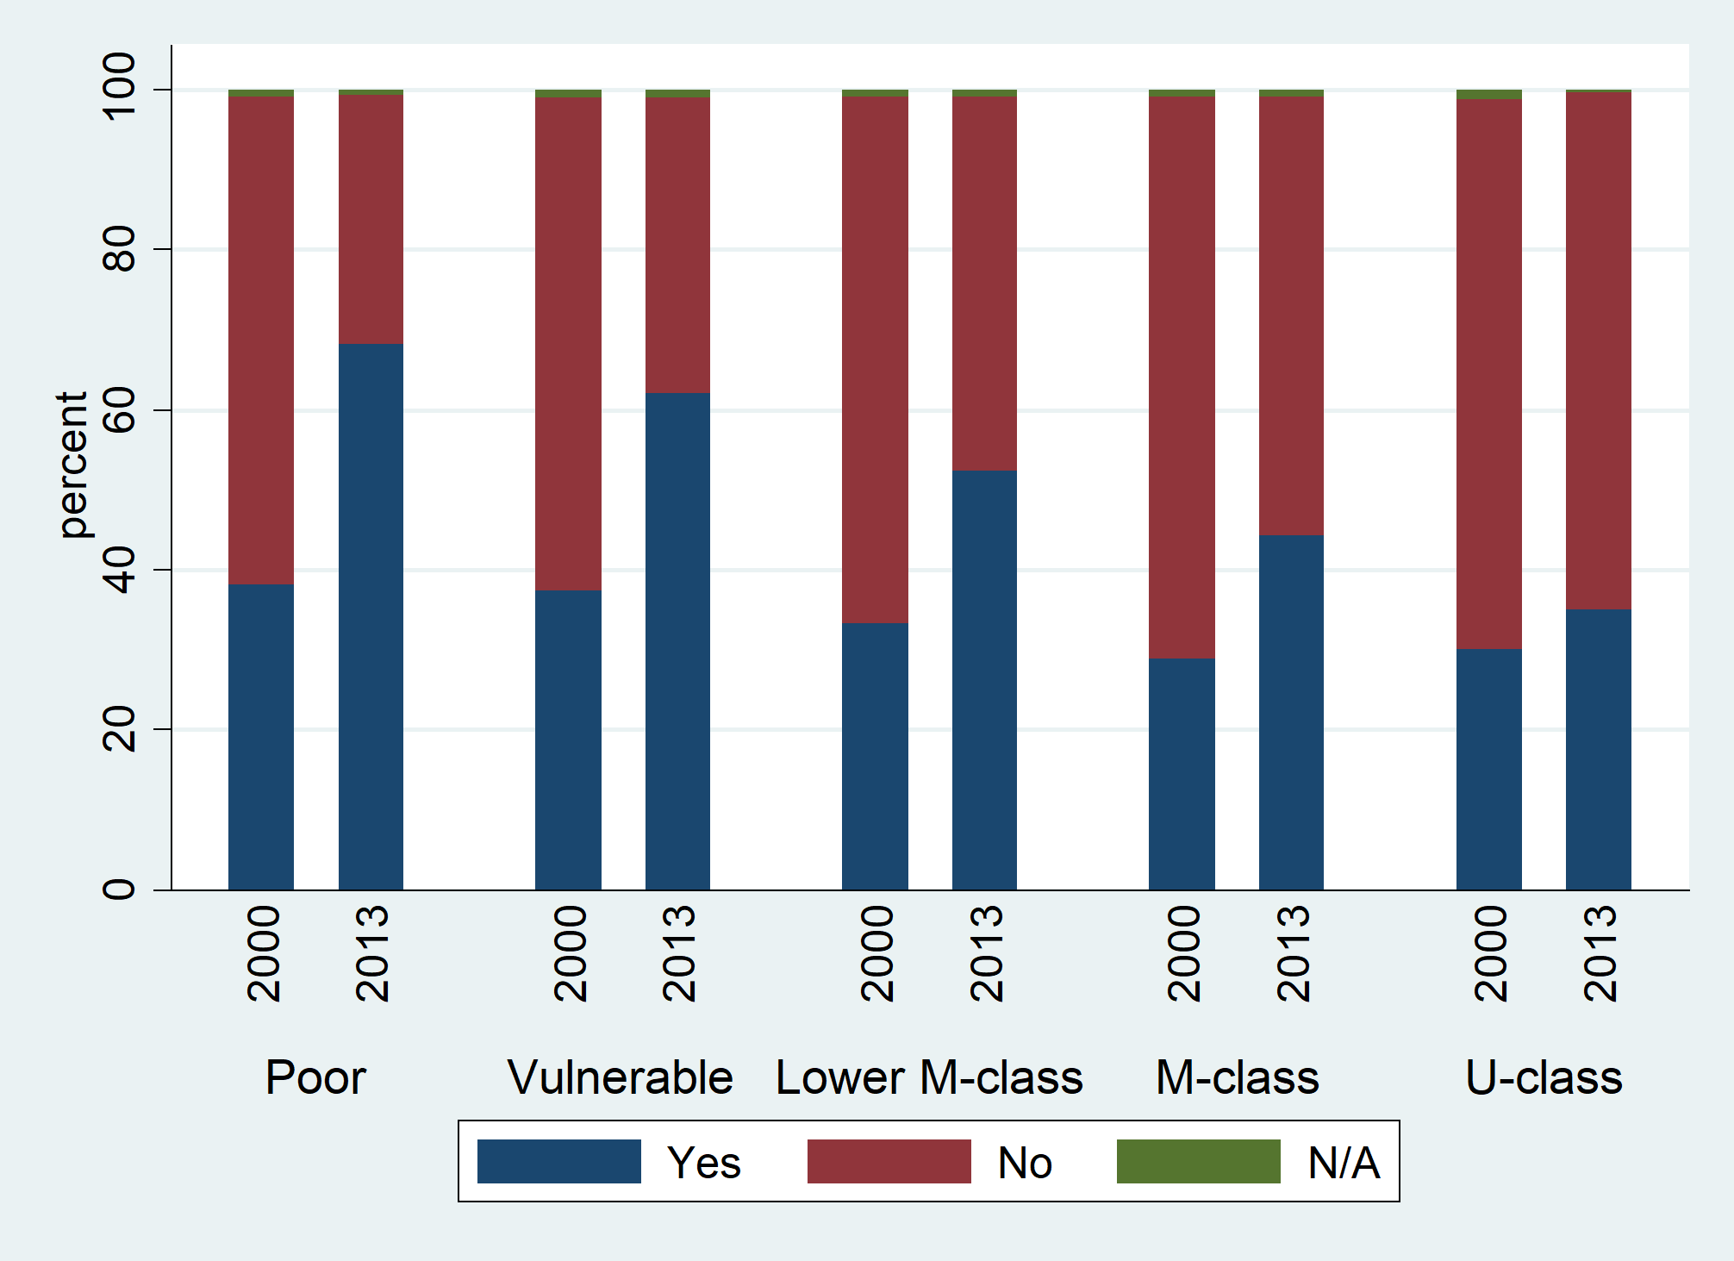
Among your expenses in the last 10 years, did. …pose you a problem?
Schooling
Transports

Slide 16
Absolute measures and perception in Morocco: 2001-2013

Slide 17
Are results from absolute measures more correlated to the welfare perception?

Slide 18
Absolute Indexes of Inequality and Polarization

Slide 19
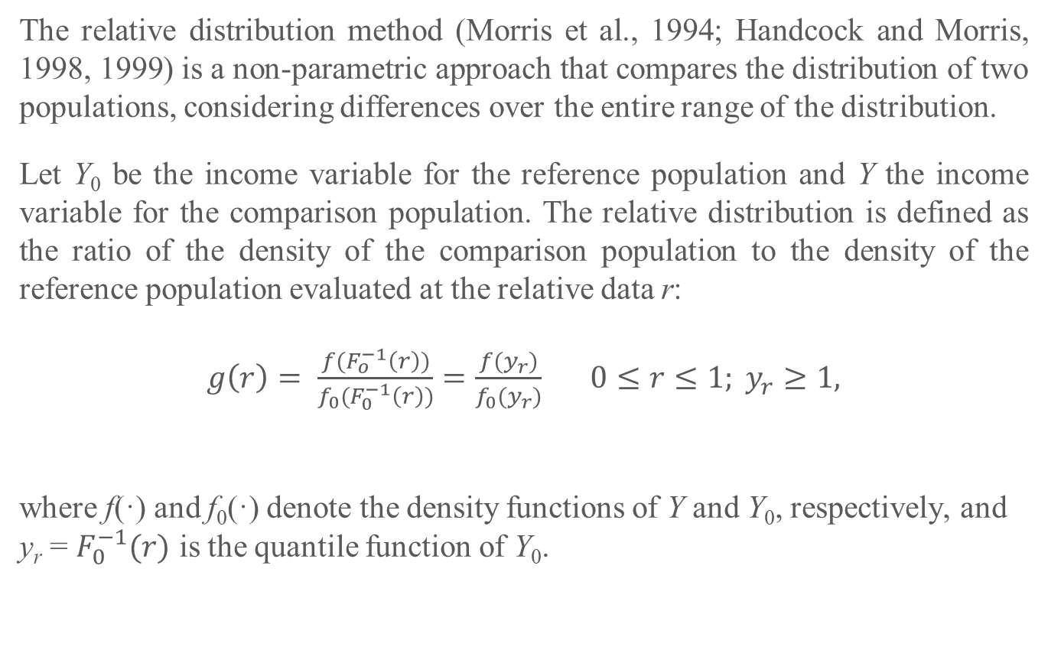
Absolute measures: the relative distribution (1)
The relative distribution method (Morris et al., 1994; Handcock and Morris, 1998, 1999) is a non-parametric approach that compares the distribution of two populations, considering differences over the entire range of the distribution.
Let Y₀ be the income variable for the reference population and Y the income variable for the comparison population. The relative distribution is defined as the ratio of the density of the comparison population to the density of the reference population evaluated at the relative data r:
$g\left(r\right)= \frac{f(F_{o}^{−1}\left(r\right))}{f_{0}(F_{0}^{−1}\left(r\right))}=\frac{f(y_{r})}{f_{0}(y_{r})}$ $0≤r≤1; y_{r}≥1,$
where f(·) and f₀(·) denote the density functions of Y and Y₀, respectively, and y_{r} = $F_{0}^{−1}(r)$ is the quantile function of Y₀.

Slide 20
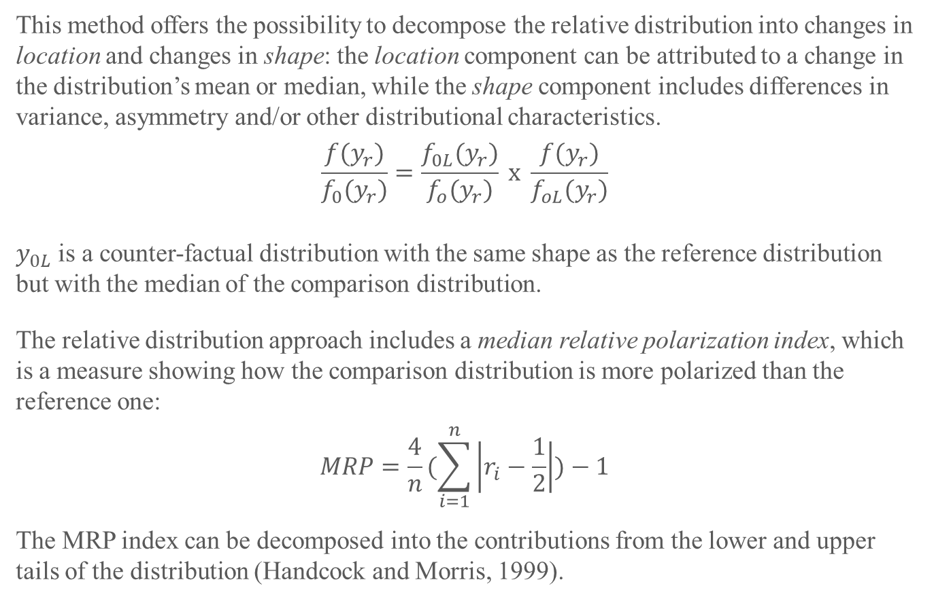
Absolute measures: the relative distribution (2)
This method offers the possibility to decompose the relative distribution into changes in location and changes in shape: the location component can be attributed to a change in the distribution’s mean or median, while the shape component includes differences in variance, asymmetry and/or other distributional characteristics.
$$\frac{f(y_{r})}{f_{0}(y_{r})}=\frac{f_{0L}(y_{r})}{f_{o}(y_{r})} x \frac{f(y_{r})}{f_{oL}(y_{r})}$$
$y_{0L}$ is a counter-factual distribution with the same shape as the reference distribution but with the median of the comparison distribution.
The relative distribution approach includes a median relative polarization index, which is a measure showing how the comparison distribution is more polarized than the reference one:
$$MRP=\frac{4}{n}(\sum_{i=1}^{n}{\left|r_{i}−\frac{1}{2}\right|)−1}$$
The MRP index can be decomposed into the contributions from the lower and upper tails of the distribution (Handcock and Morris, 1999).

Slide 21
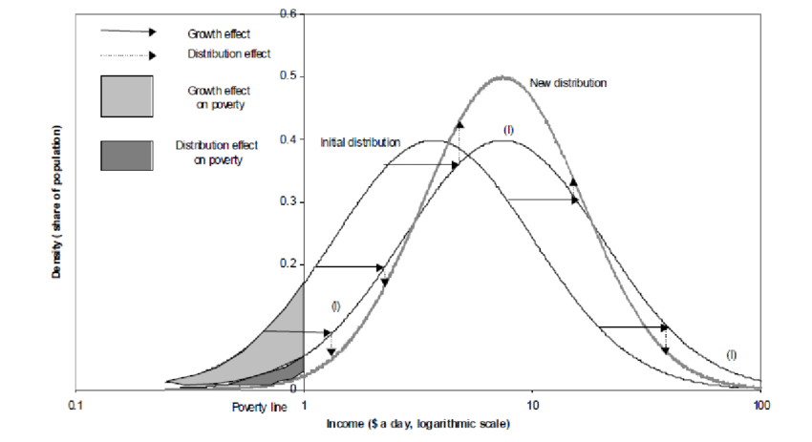
Absolute measures: the relative distribution (3)

Slide 22
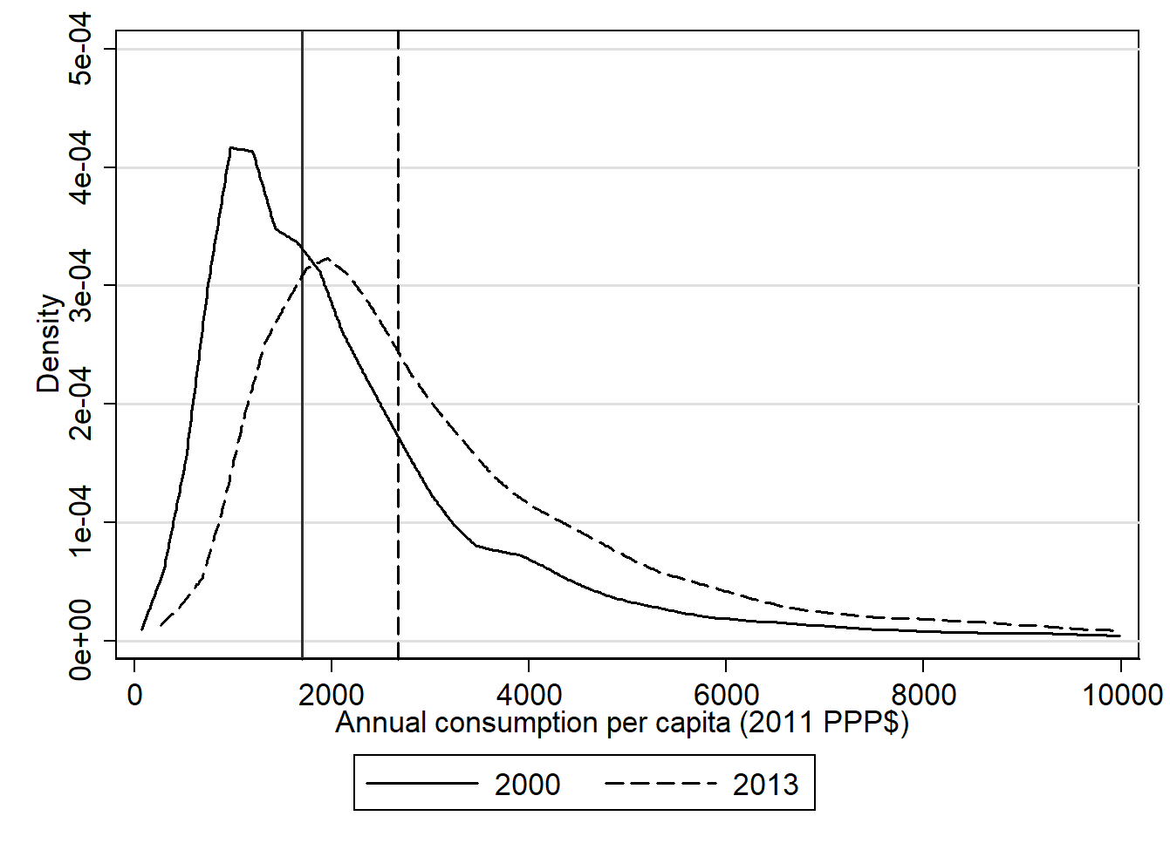
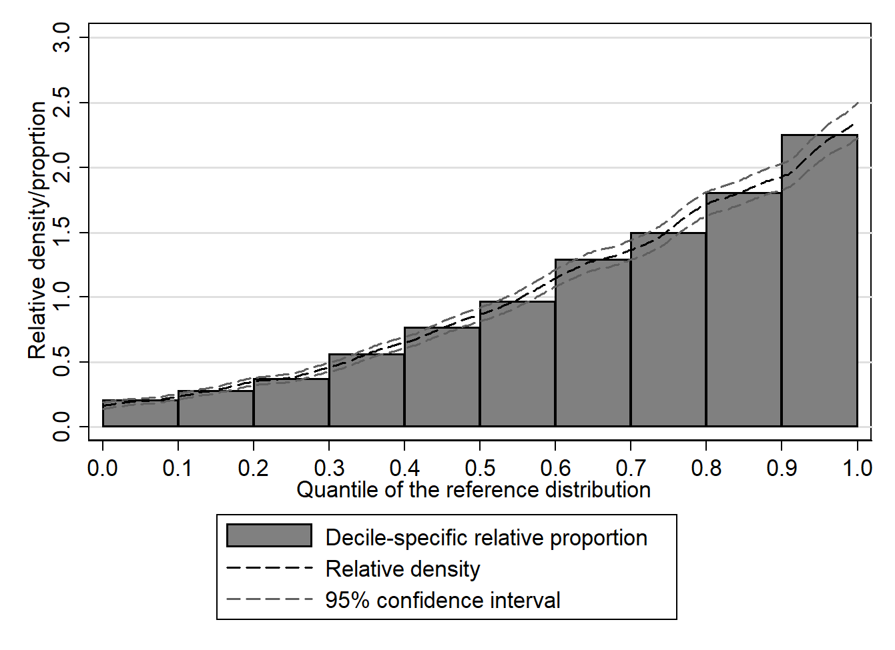
Consumption in Morocco: 2001-2013
Kernel densities: 2001-2013
Overall

Slide 23
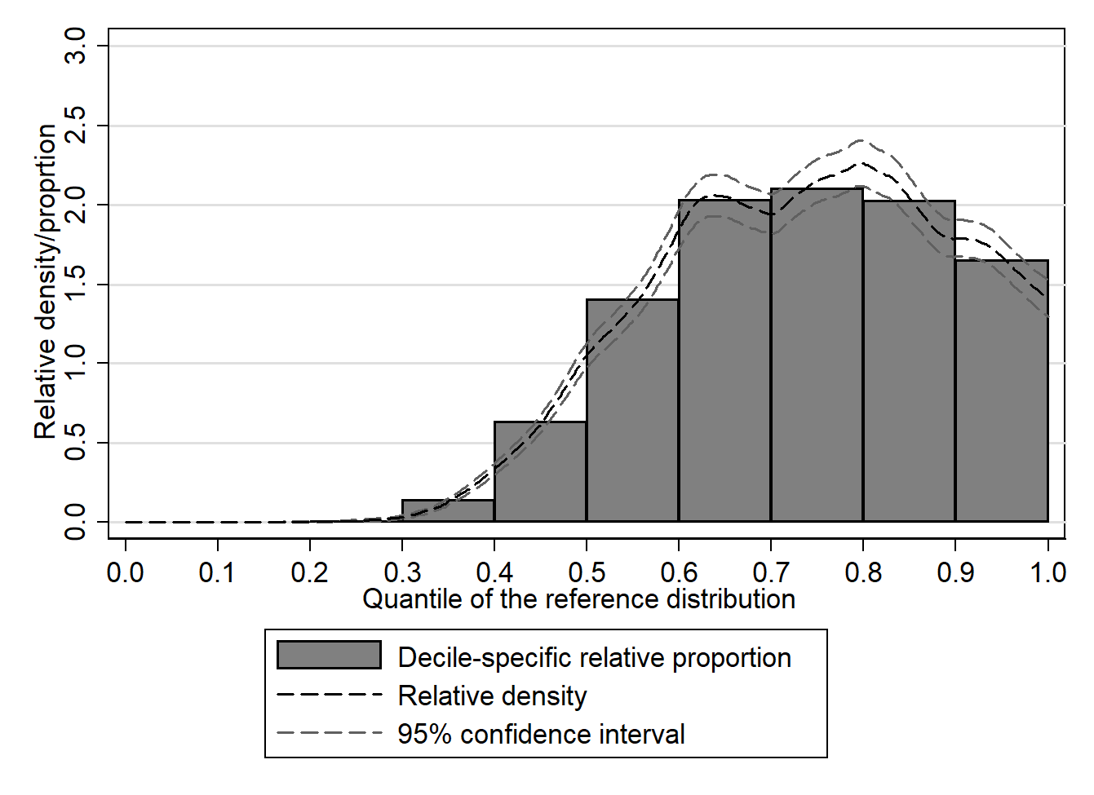
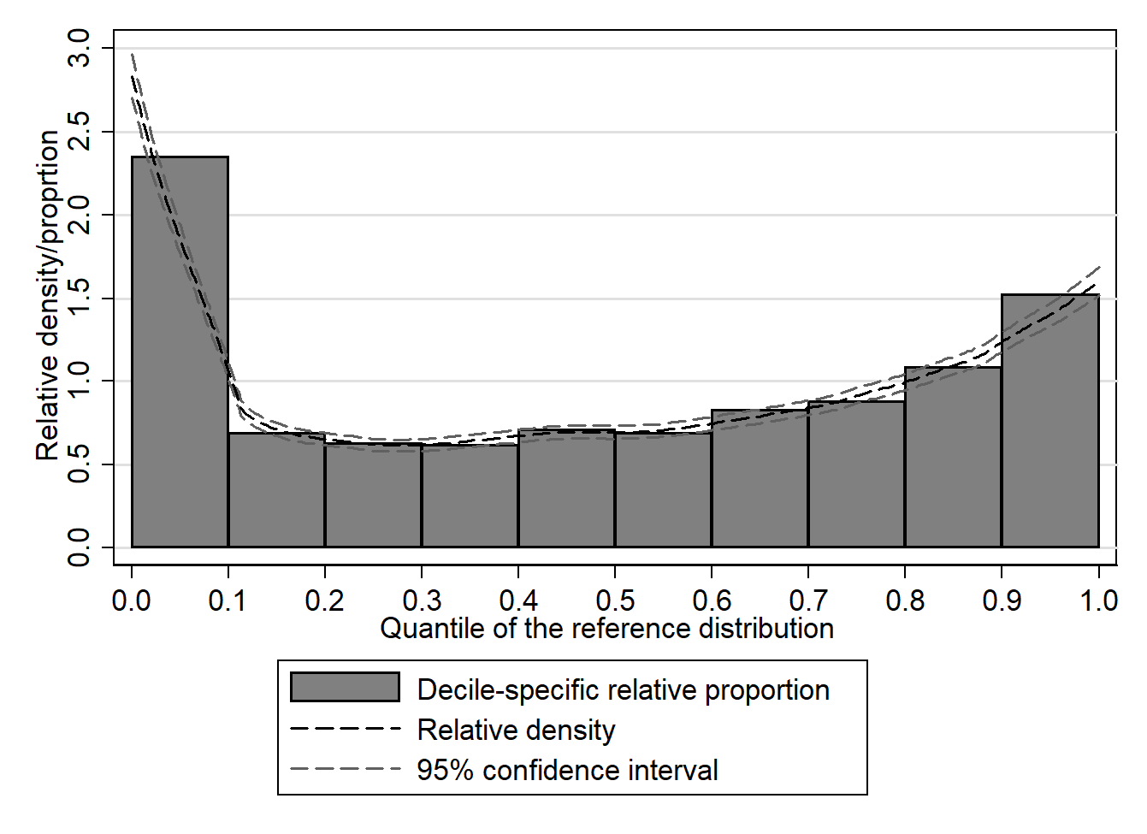
Decomposition in ‘location’ and ‘shape’
Location effect
Shape effect

Slide 24
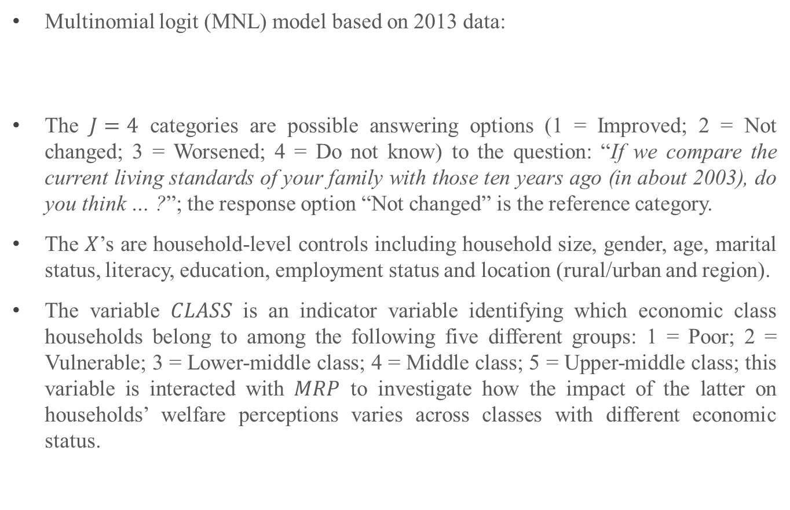
Testing the association between consumption polarization and household self-reported welfare (1)
Multinomial logit (MNL) model based on 2013 data:
The $J=4$ categories are possible answering options (1 = Improved; 2 = Not changed; 3 = Worsened; 4 = Do not know) to the question: “If we compare the current living standards of your family with those ten years ago (in about 2003), do you think … ?”; the response option “Not changed” is the reference category.
The $X$’s are household-level controls including household size, gender, age, marital status, literacy, education, employment status and location (rural/urban and region).
The variable $CLASS$ is an indicator variable identifying which economic class households belong to among the following five different groups: 1 = Poor; 2 = Vulnerable; 3 = Lower-middle class; 4 = Middle class; 5 = Upper-middle class; this variable is interacted with $MRP$ to investigate how the impact of the latter on households’ welfare perceptions varies across classes with different economic status.
$$ln\left[\frac{Pr\left(Y_{i}=j\right)}{Pr\left(Y_{i}=2\right)}\right]=α_{j}+\sum_{h=1}^{5}{β_{jh}\left(MRP_{ih}×CLASS_{h}\right)}+\sum_{k=1}^{9}{γ_{jk}X_{ik}}, i=1,2,…,N, j=1,3,4.$$
27

Slide 25
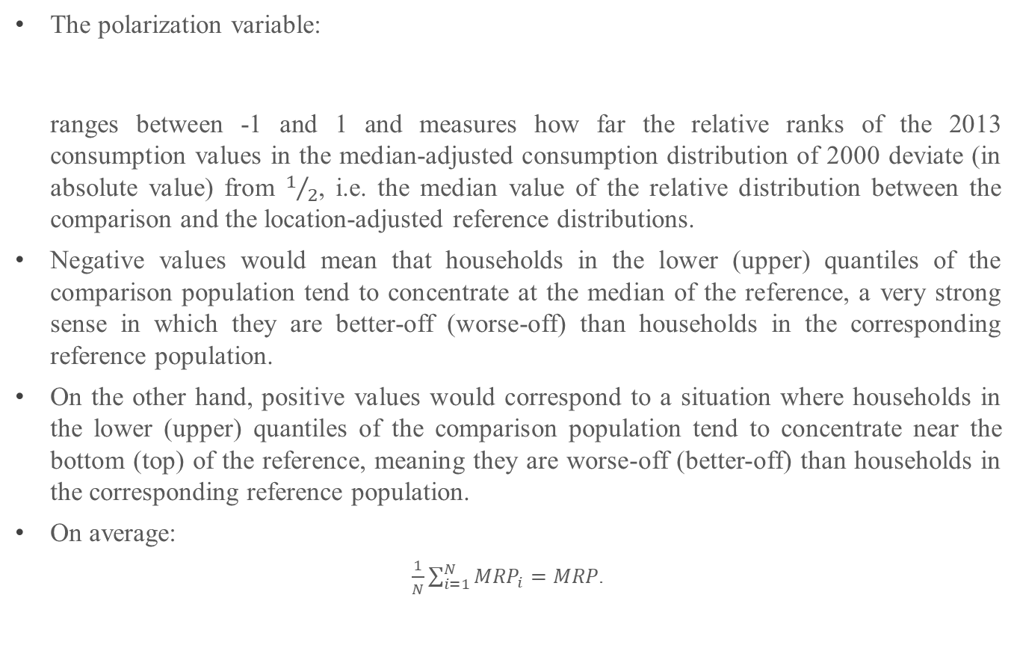

Testing the association between consumption polarization and household self-reported welfare (2)
The polarization variable:
ranges between -1 and 1 and measures how far the relative ranks of the 2013 consumption values in the median-adjusted consumption distribution of 2000 deviate (in absolute value) from $1/2$, i.e. the median value of the relative distribution between the comparison and the location-adjusted reference distributions.
Negative values would mean that households in the lower (upper) quantiles of the comparison population tend to concentrate at the median of the reference, a very strong sense in which they are better-off (worse-off) than households in the corresponding reference population.
On the other hand, positive values would correspond to a situation where households in the lower (upper) quantiles of the comparison population tend to concentrate near the bottom (top) of the reference, meaning they are worse-off (better-off) than households in the corresponding reference population.
On average:
$\frac{1}{N}\sum_{i=1}^{N}{{MRP}_{i}=MRP}$.
$$MRP_{i}=4|r_{i}−\frac{1}{2}|−1, i=1,2,...,N,$$
28

Slide 26

Testing the association between consumption polarization and household self-reported welfare (3)
Interpretation in terms of relative risk rates ($RRR$s):
      $RRR>1$ indicates that the probability of selecting, say, the response option “Improved” compared to that of responding “Not changed” increases as the variable $MRP$ (and hence polarization) increases – the comparison outcome is more likely.
      $RRR<1$ indicates that the probability of selecting the response option “Improved” compared to that of responding “Not changed” decreases with polarization – the reference outcome is more likely.
(a) By classes
(b) By quintiles
29

Slide 27
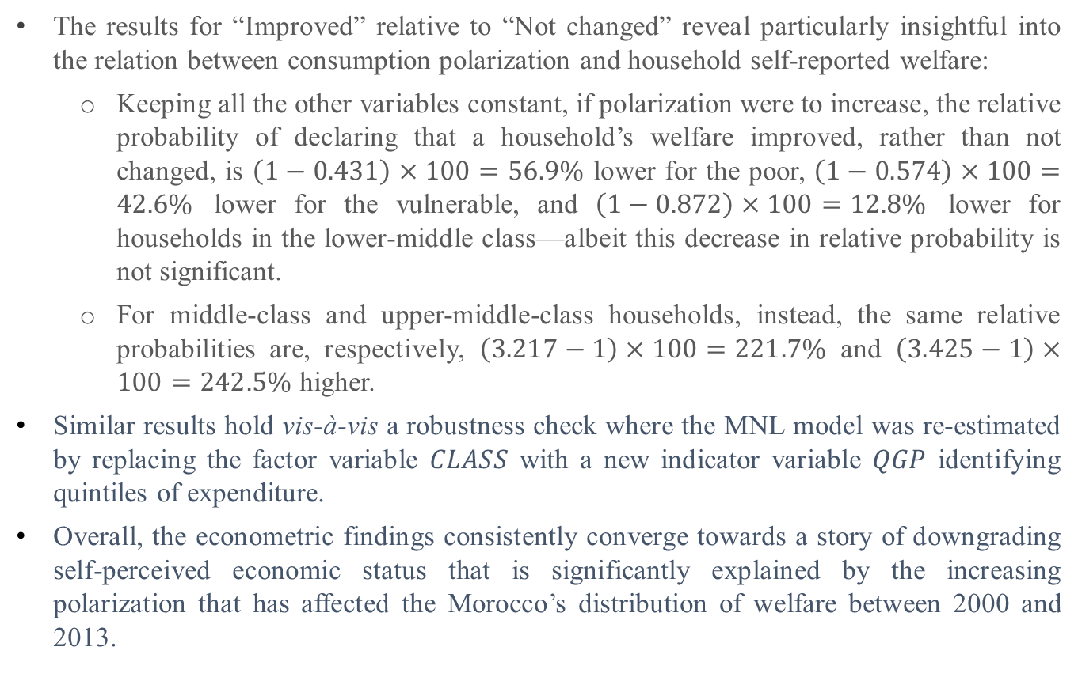
Testing the association between consumption polarization and household self-reported welfare (4)
The results for “Improved” relative to “Not changed” reveal particularly insightful into the relation between consumption polarization and household self-reported welfare:
      Keeping all the other variables constant, if polarization were to increase, the relative probability of declaring that a household’s welfare improved, rather than not changed, is $\left(1−0.431\right)×100=56.9\%$ lower for the poor, $\left(1−0.574\right)×100=42.6\%$ lower for the vulnerable, and $\left(1−0.872\right)×100=12.8\%$ lower for households in the lower-middle class—albeit this decrease in relative probability is not significant.
      For middle-class and upper-middle-class households, instead, the same relative probabilities are, respectively, $\left(3.217−1\right)×100=221.7\%$ and $\left(3.425−1\right)×100=242.5\%$ higher.
    Similar results hold vis-à-vis a robustness check where the MNL model was re-estimated by replacing the factor variable $CLASS$ with a new indicator variable $QGP$ identifying quintiles of expenditure.
    Overall, the econometric findings consistently converge towards a story of downgrading self-perceived economic status that is significantly explained by the increasing polarization that has affected the Morocco’s distribution of welfare between 2000 and 2013.
30

Slide 28
شكرا

